Slide 1

PROJECT TITLE – CAR MARKET TRENDS ANALYSIS WITH CAR DEKHO DATA
NAME : UJJWAL GUPTA
AICTE STU ID : STU68374882bc9891748453506
AICTE INTERNSHIP ID : INTERNSHIP_17830691666a4779eecfe8a

Slide 2

PROBLEM STATEMENT
The used car market is growing fast, but estimating the correct resale price is very difficult. This is because car prices change constantly based on many factors like the car's age, fuel type, transmission, and total mileage. Without data analysis, people often misprice vehicles, creating a clear need to study historical market data to find fair value.

Slide 3
PROJECT DESCRIPTION
.
Project Type: A data analytics case study based on the Car Dekho dataset to understand used vehicle market trends.
Core Method: Uses Python to clean data and calculate new metrics like Vehicle Age (updated to 2026) and value drop (Depreciation).
Visual Insights: Uses simple charts and statistical tables to find out which features change a car's resale value.
Main Goal: Turns raw vehicle numbers into easy insights to help buyers and sellers find fair market prices

Slide 4

WHO ARE THE END USERS?
Used Car Buyers: People looking to buy a pre-owned vehicle at a fair price.
Individual Car Sellers: Private owners who want to know the accurate resale value of their vehicle before selling.
Used Car Dealers: Car businesses and dealerships that need data insights to price their inventory competitively.
Market Analysts: Researchers tracking how different car brands, fuel types, and transmissions hold their value over time.

Slide 5

TECHNOLOGY USED
Programming Language: Python – Used as the core language for all data loading, manipulation, and statistical data processing.
Data Manipulation: Pandas – Used to read the CarDekho CSV file, handle rows and columns, clean null values, and create new columns (Vehicle_Age and Depreciation).
Data Visualization: Matplotlib & Seaborn – Used to build simple, high-quality charts like distribution plots, box plots, and the correlation matrix heatmap.
Development Environment: Google Colab – Used as the interactive environment to write and run the Python data analysis code.

Slide 6
RESULTS
Manufacturing Span: The dataset covers vehicles built from 2003 (Maruti 800) to 2018 (Vitara Brezza).
Price Range: Used car prices range from a minimum of 0.1 Lakh INR (10,000 INR) to a maximum of 35.0 Lakh INR.
Market Saliency: The most sold car model is the Honda City (appears 26 times), while the least sold is the Hyosung GT250R bike.
Github Link

Slide 7
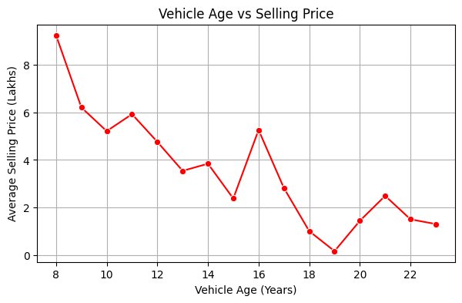
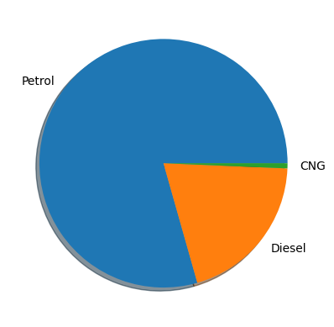
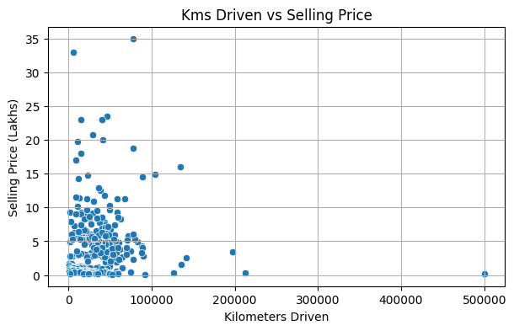
RESULTS
Github Link

Slide 8
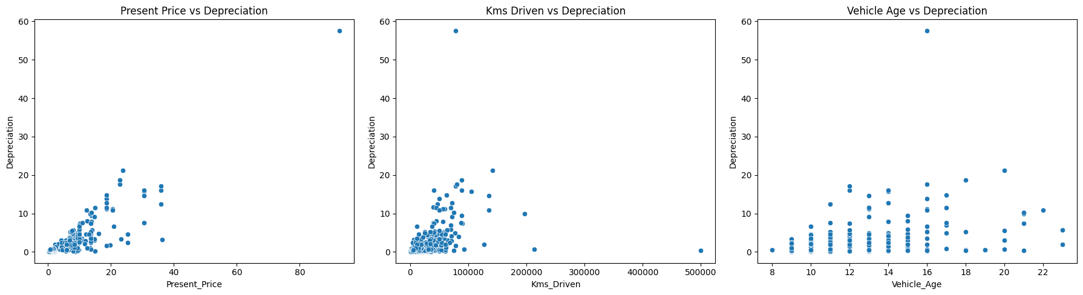
RESULTS
Github Link

Slide 9
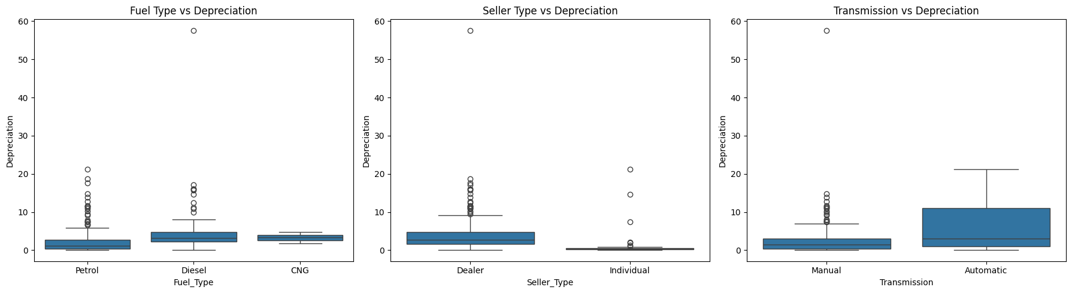
RESULTS
Github Link

Slide 10
THANK YOU
.
.

